Slide 1
Future of Computing: Moore’s Law & Its Implications 15-213: Introduction to Computer Systems 27th Lecture, Dec. 3, 2015
Instructors:
Randal E. Bryant and David R. O’Hallaron

Slide 2
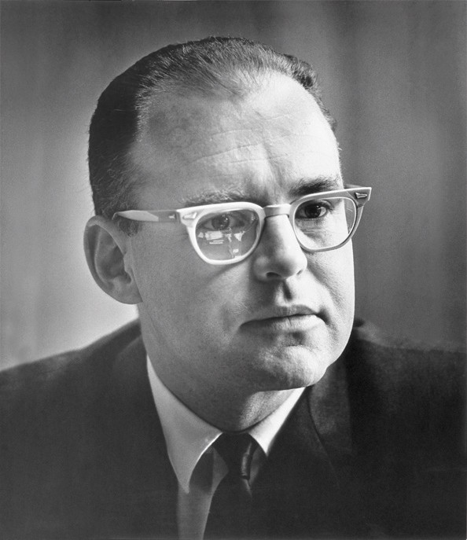
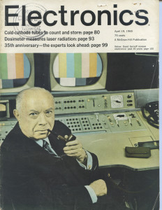
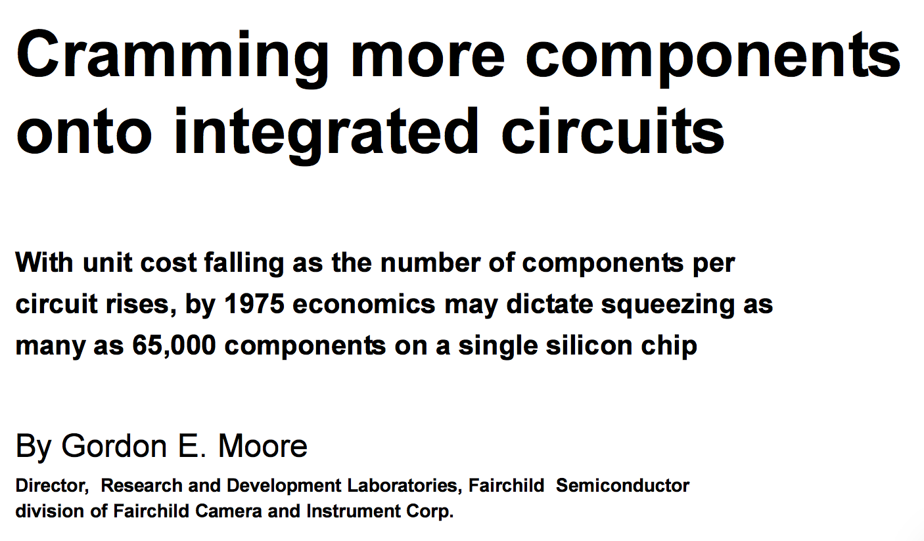
Moore’s Law Origins
April 19, 1965

Slide 3
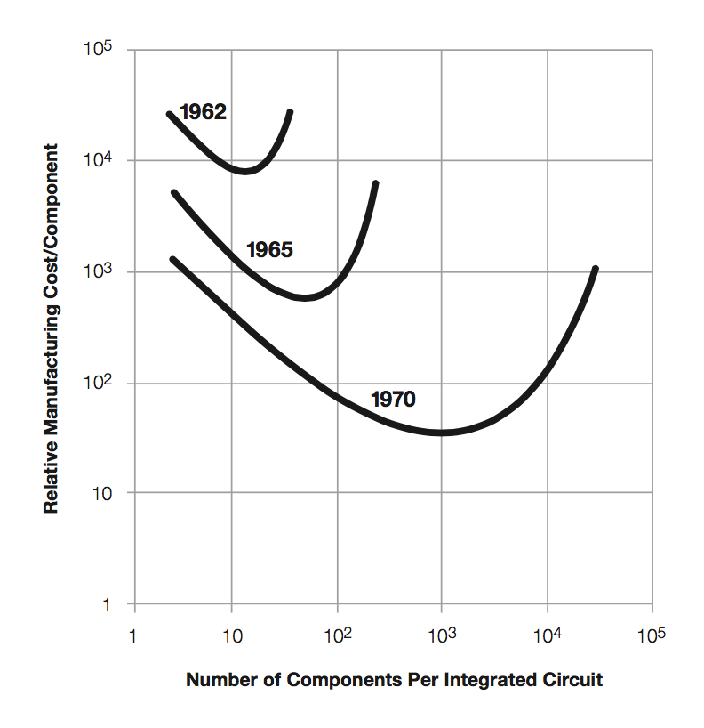
Moore’s Law Origins
Moore’s Thesis
Minimize price per device
Optimum number of devices / chip increasing 2x / year
Later
2x / 2 years
“Moore’s Prediction”
1965: 50
1970: 1000

Slide 4
Moore’s Law: 50 Years
Sample of
117 processor chips

Slide 5
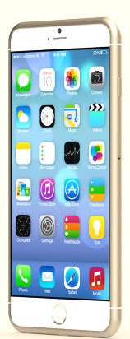
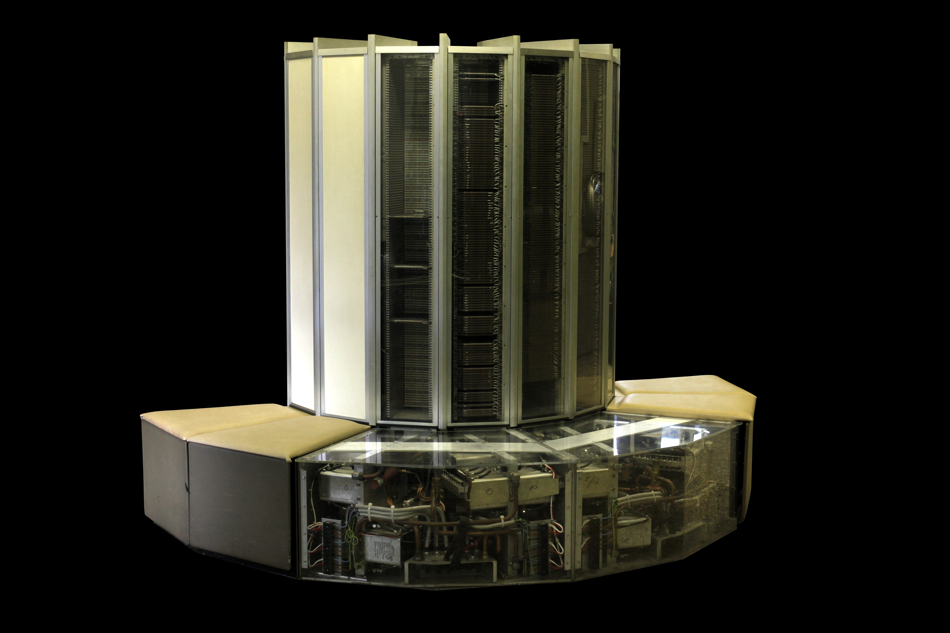
What Moore’s Law Has Meant
1976 Cray 1
250 M Ops/second
~170,000 chips
0.5B transistors
5,000 kg, 115 KW
$9M
80 manufactured
2014 iPhone 6
> 4 B Ops/second
~10 chips
> 3B transistors
120 g, < 5 W
$649
10 million sold in first 3 days

Slide 6
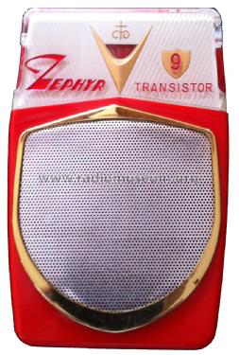
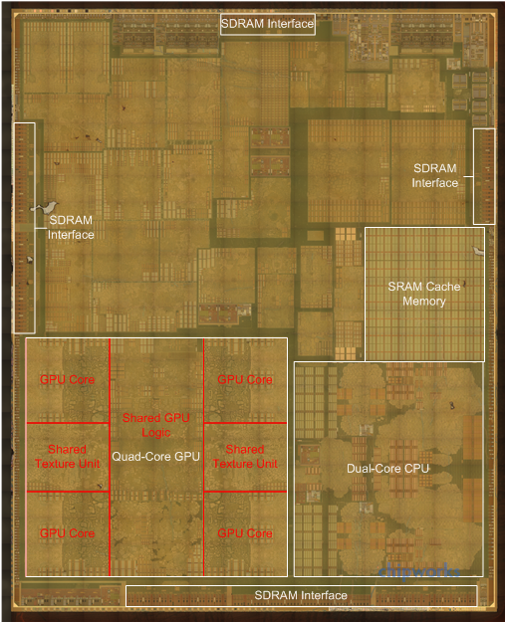
What Moore’s Law Has Meant
1965 Consumer Product
2015 Consumer Product
Apple A8 Processor
2 B transistors

Slide 7
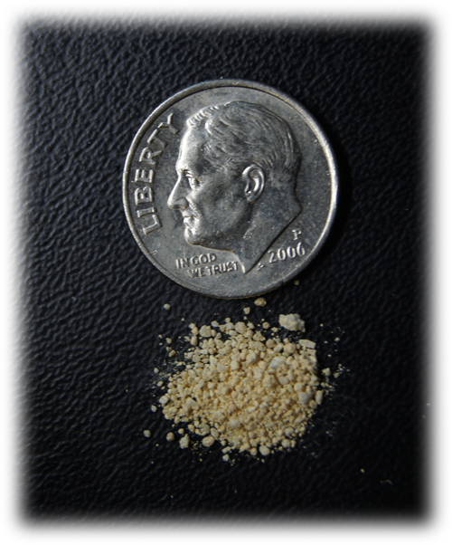
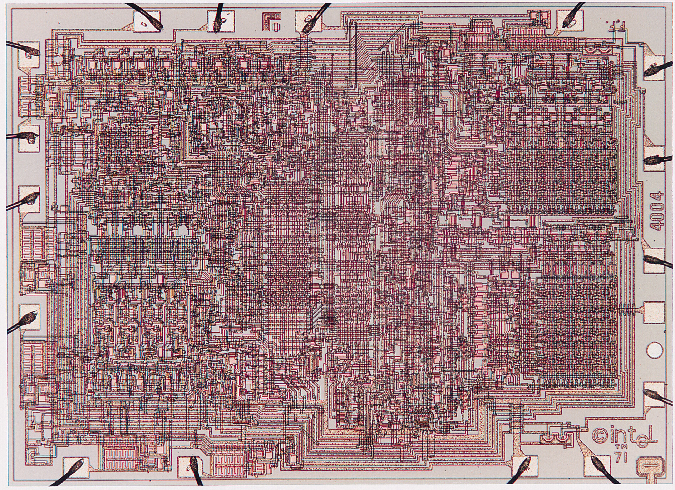
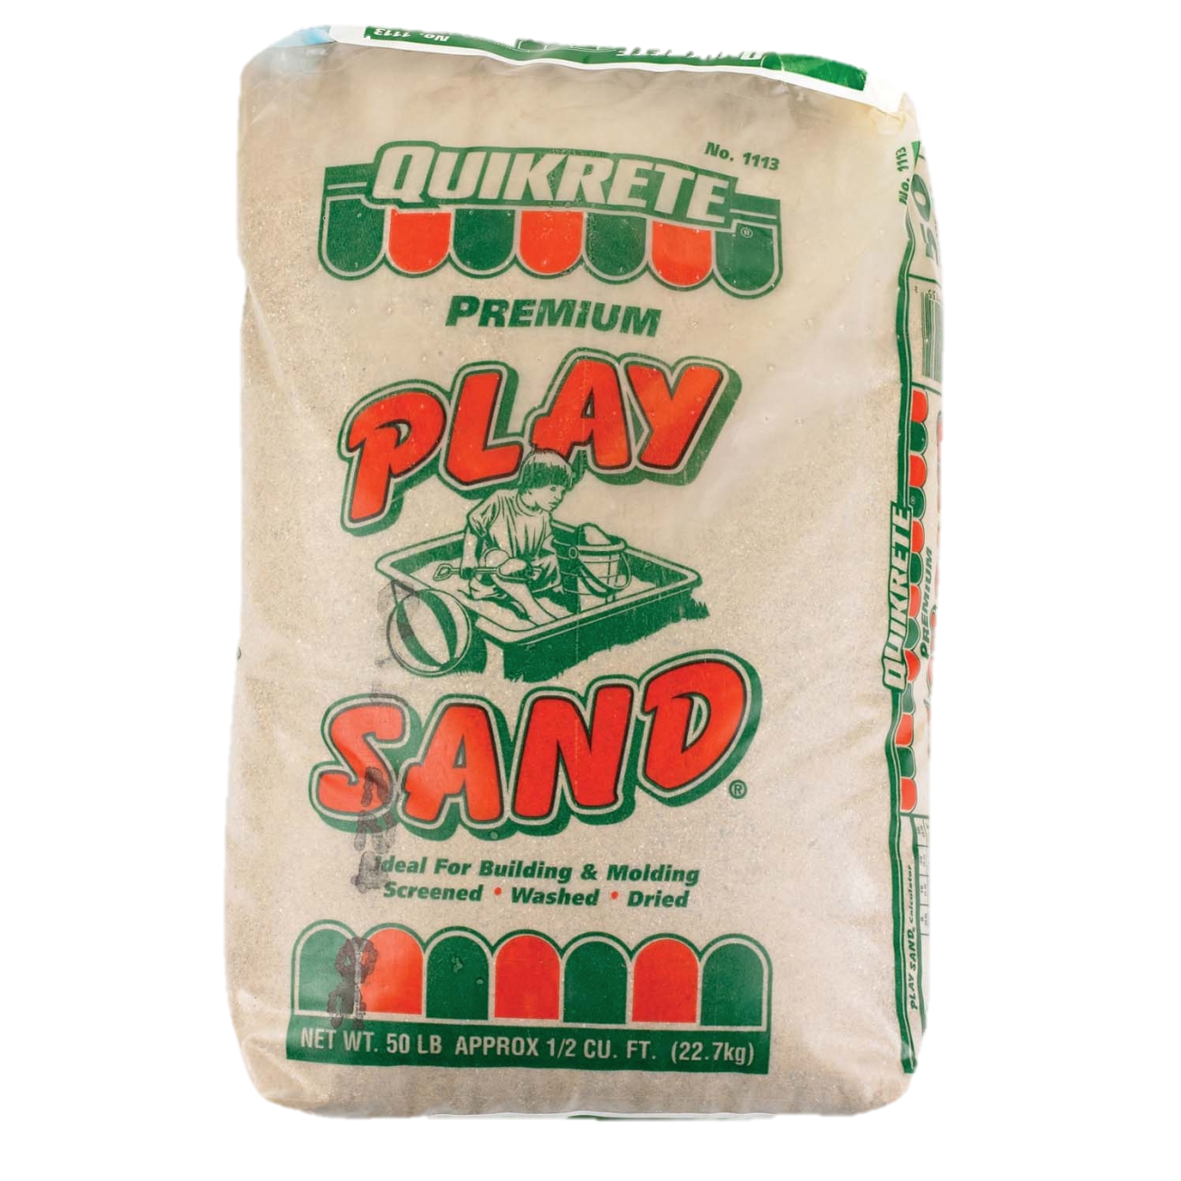
Visualizing Moore’s Law to Date
If transistors were the size of a grain of sand
Intel 4004
1970
2,300 transistors
0.1 g
Apple A8
2014
2 B transistors
88 kg

Slide 8
Moore’s Law Economics
Better
Products
Sales $$
Capital +
R&D Investment
Product
Design
New Technology
Consumer products sustain the
$300B semiconductor industry

Slide 9
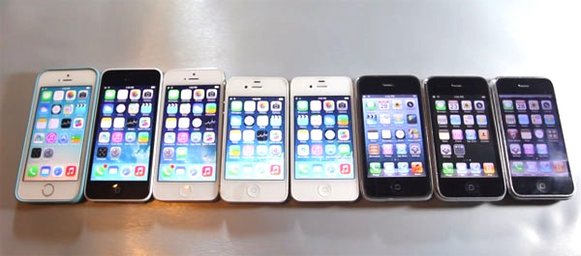
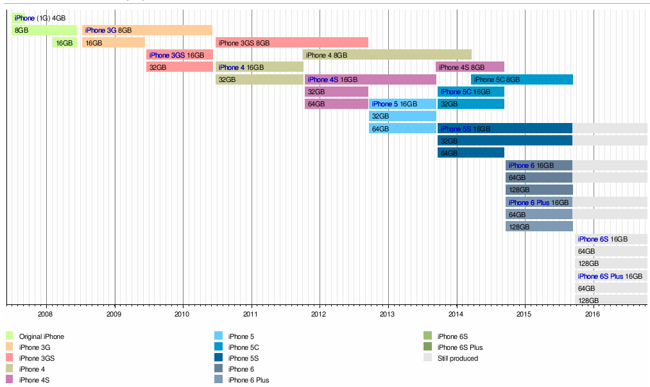
What Moore’s Law Has Meant
9 generations of iPhone since 2007

Slide 10
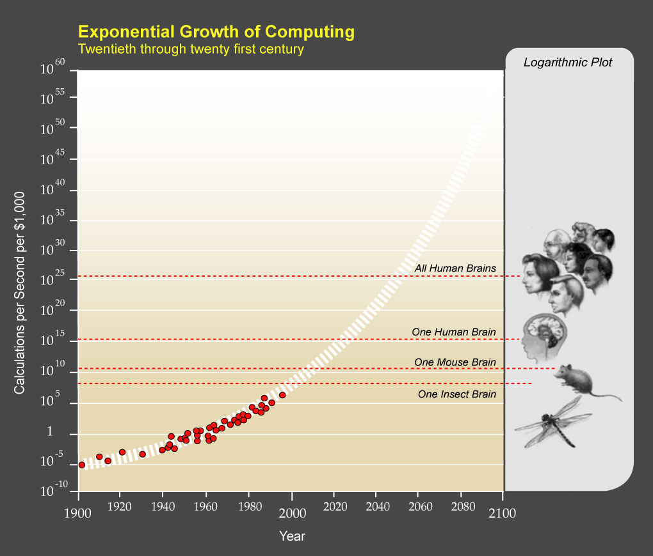
What Moore’s Law Could Mean
Kurzweil, The Singularity is Near, 2005

Slide 11
What Moore’s Law Could Mean
2015 Consumer Product
2065 Consumer Product
Portable
Low power
Will drive markets & innovation
?

Slide 12
Requirements for Future Technology
Must be suitable for portable, low-power operation
Consumer products
Internet of Things components
Not cryogenic, not quantum
Must be inexpensive to manufacture
Comparable to current semiconductor technology
O(1) cost to make chip with O(N) devices
Need not be based on transistors
Memristors, carbon nanotubes, DNA transcription, ...
Possibly new models of computation
But, still want lots of devices in an integrated system

Slide 13
Moore’s Law: 100 Years
10¹⁷ devices!

Slide 14
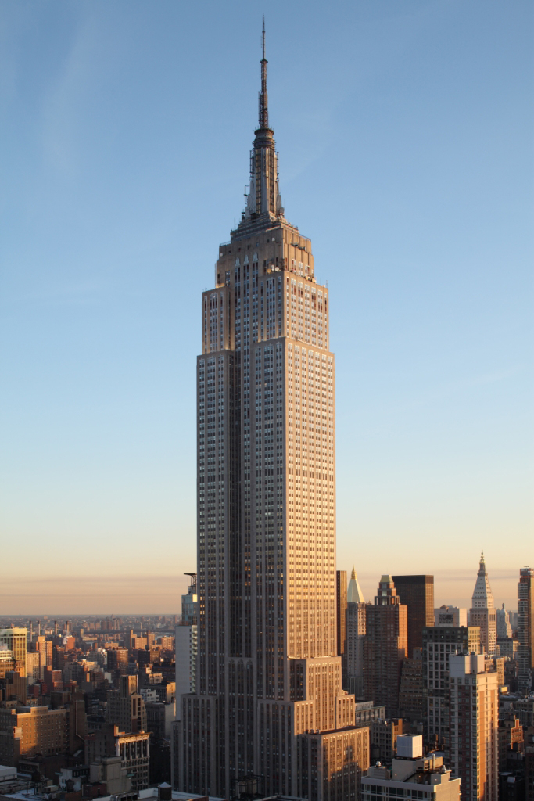
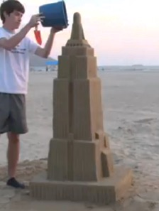
Visualizing 10¹⁷ Devices
If devices were the size of a grain of sand
0.1 m³
3.5 X 10⁹ grains
1 million m³
0.35 X 10¹⁷ grains

Slide 15
Increasing Transistor Counts
Chips have gotten bigger
1 area doubling / 10 years
Transistors have gotten smaller
4 density doublings / 10 years
Will these trends continue?

Slide 16
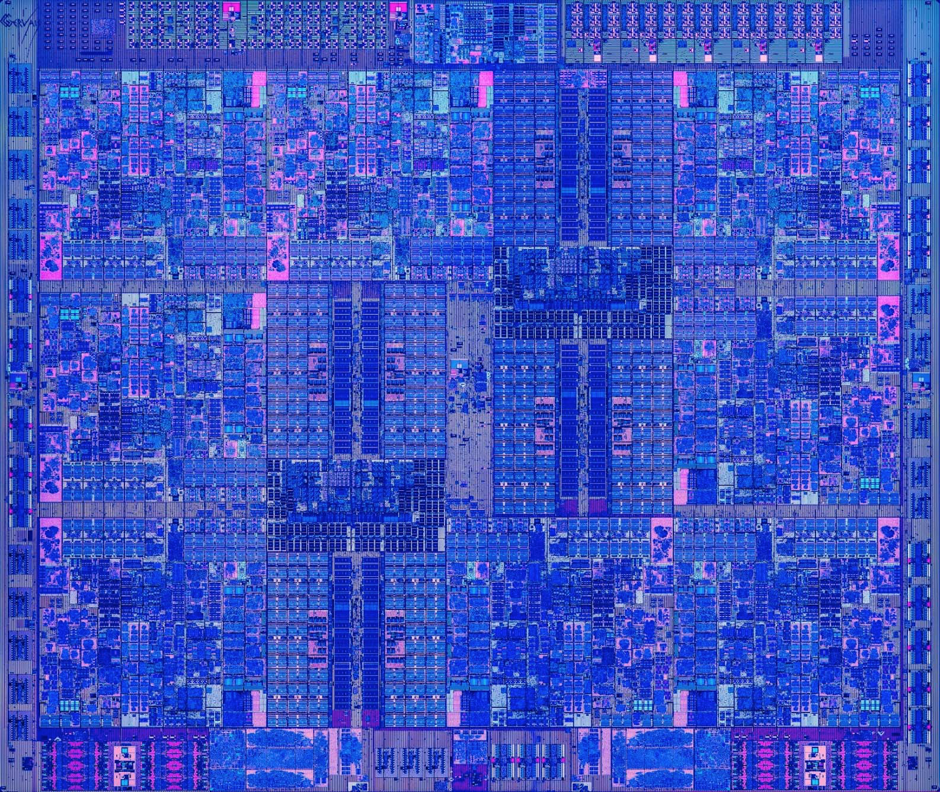
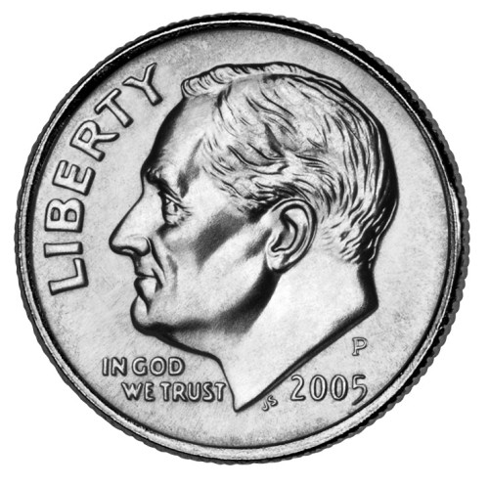
Chips Have Gotten Bigger
Intel 4004
1970
2,300 transistors
12 mm²
Apple A8
2014
2 B transistors
89 mm²
IBM z13
205
4 B transistors
678 mm²

Slide 17
Chip Size Trend
2x every 9.5 years

Slide 18
Chip Size Extrapolation
173 cm²

Slide 19
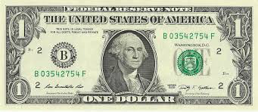
Extrapolation: The iPhone 31s
Apple A59
2065
10¹⁷ transistors
173 cm²

Slide 20
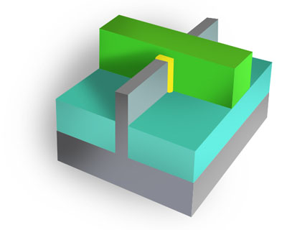
Transistors Have Gotten Smaller
Area A
N devices
Linear Scale L
L

Slide 21
Linear Scaling Trend
1/2x every 5 years ➔
2x transistor density every 2.5 years

Slide 22
Decreasing Feature Sizes
Apple A8
2014
2 B transistors
L = 211 nm
Intel 4004
1970
2,300 transistors
L = 72,000 nm

Slide 23
Linear Scaling Trend
Submillimeter
Submicrometer

Slide 24
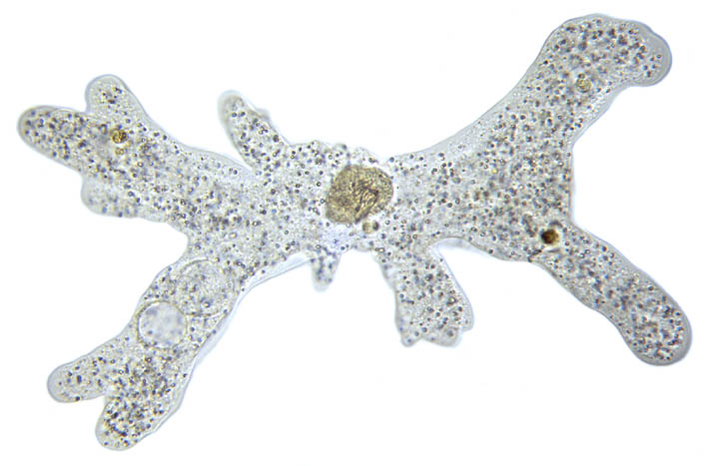

Submillimeter Dimensions
10⁻³
1 millimeter (mm)
500μm: Length of amoeba
10⁻⁴
72μm: Intel 4004 linear scale
50μm: Average size of cell in human body
10⁻⁵
10μm: Thickness of sheet of plastic food wrap
5μm: Spider silk thickness
2μm: E coli bacterium length
10⁻⁶
1 micrometer (μm)

Slide 25

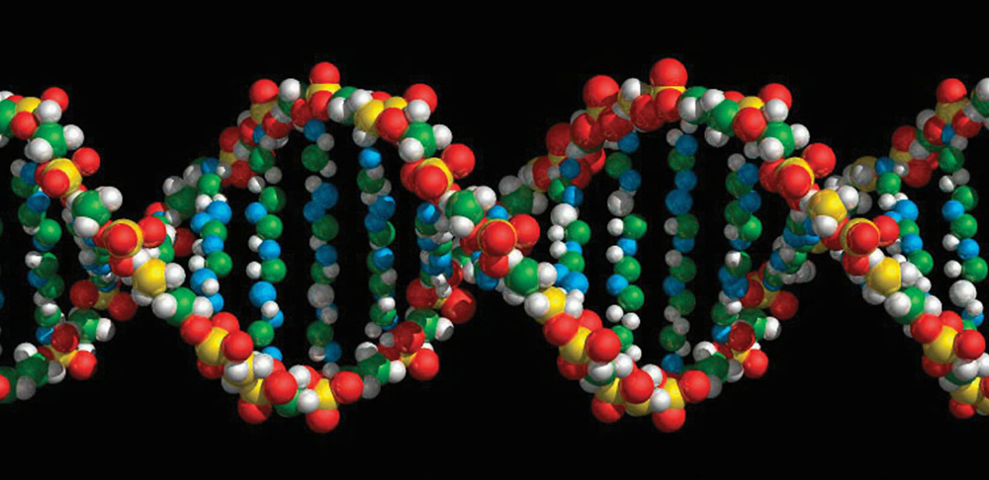
Submicrometer Dimensions
10⁻⁶
1 micrometer (μm)
400-700nm: Visible light wavelengths
211nm: Apple A8 linear scale
10⁻⁷
30nm: Minimum cooking oil smoke particle diameter
10⁻⁸
9nm: Cell membrane thickness
2nm: DNA helix diameter
10⁻⁹
1 nanometer (nm)
1nm: Carbon nanotube diameter

Slide 26
Linear Scaling Extrapolation
230 pm

Slide 27
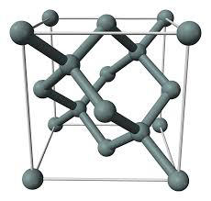
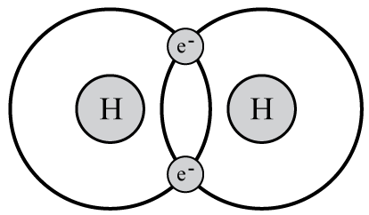
Subnanometer Dimensions
1 nanometer (nm)
10⁻⁹
1nm: Carbon nanotube diameter
543pm: Silicon crystal lattice spacing
230pm: 2065 linear scale projection
10⁻¹⁰
74pm: Spacing between atoms in hydrogen molecule
53pm: Electron-proton spacing in hydrogen (Bohr radius)
10⁻¹¹
2.4pm: Electron wavelength (Compton wavelength)
1 picometer
(pm)
10⁻¹²

Slide 28
Reaching 2065 Goal
Target
10¹⁷ devices
400 mm²
L = 63 pm
Is this possible?
No!
Not with 2-d
fabrication

Slide 29
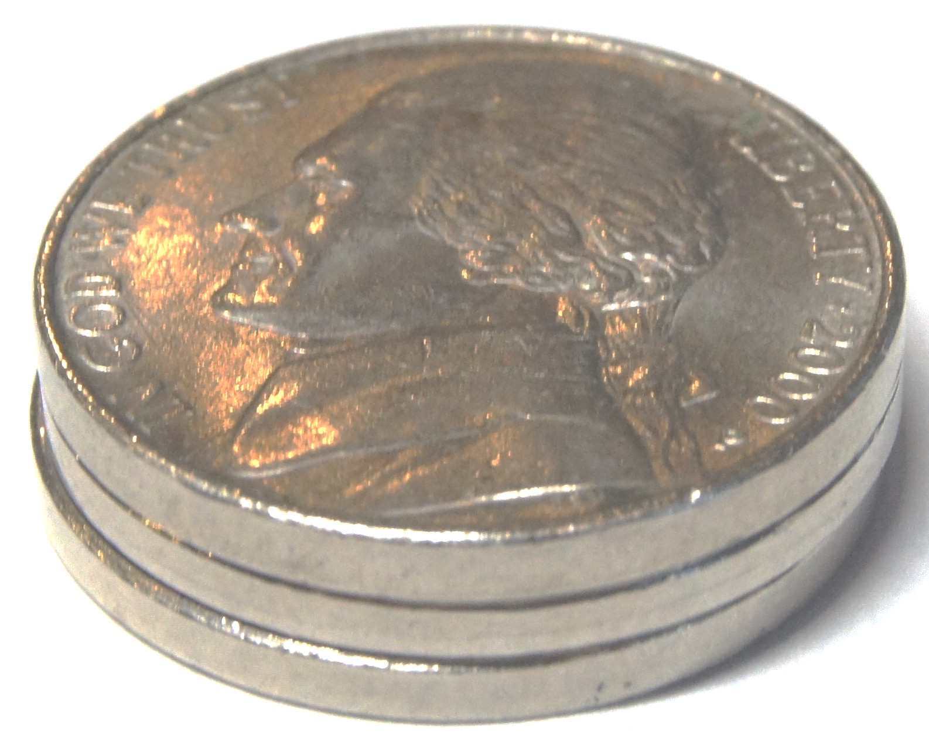
Fabricating in 3 Dimensions
2000 mm³
5 mm
20 mm
20 mm
Parameters
10¹⁷ devices
100,000 logical layers
Each 50 nm thick
~1,000,000 physical layers
To provide wiring and isolation
L = 20 nm
10x smaller than today
2065 mm³

Slide 30
3D Fabrication Challenges
Yield
How to avoid or tolerate flaws
Cost
High cost of lithography
Power
Keep power consumption within acceptable limits
Limited energy available
Limited ability to dissipate heat

Slide 31
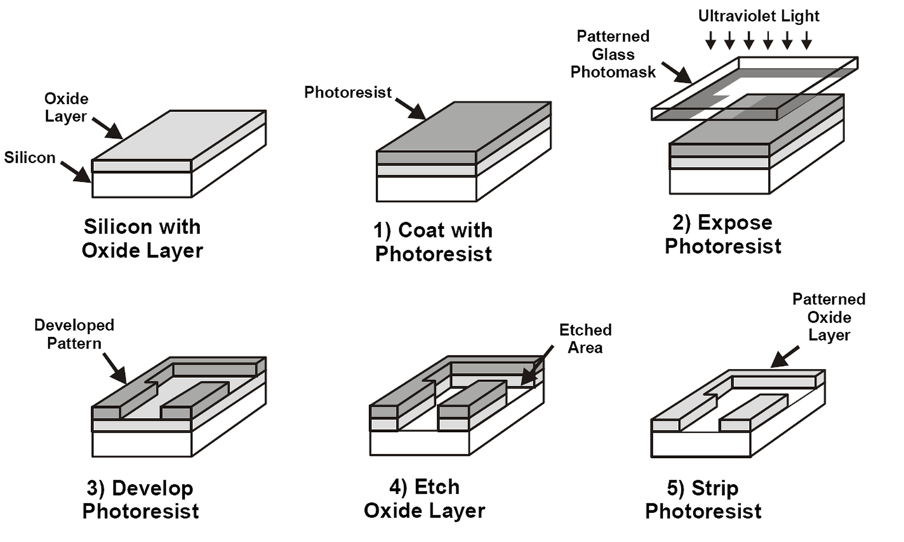
Photolithography
Pattern entire chip in one step
Modern chips require ~60 lithography steps
Fabricate N transistor system with O(1) steps

Slide 32
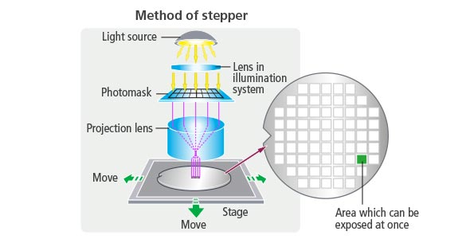
Fabrication Costs
Stepper
Most expensive equipment in fabrication facility
Rate limiting process step
18s / wafer
Expose 858 mm² per step
1.2% of chip area

Slide 33
Fabrication Economics
Currently
Fixed number of lithography steps
Manufacturing cost $10–$20 / chip
Including amortization of facility
Fabricating 1,000,000 physical layers
Cannot do lithography on every step
Options
Chemical self assembly
Devices generate themselves via chemical processes
Pattern multiple layers at once

Slide 34
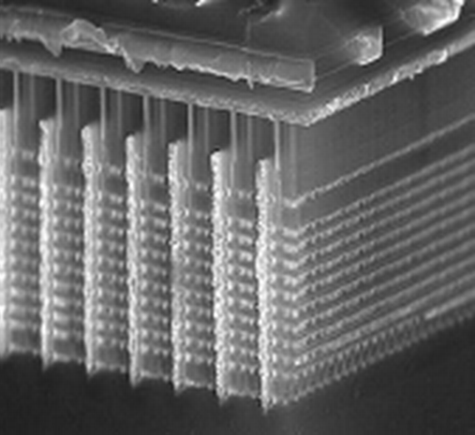
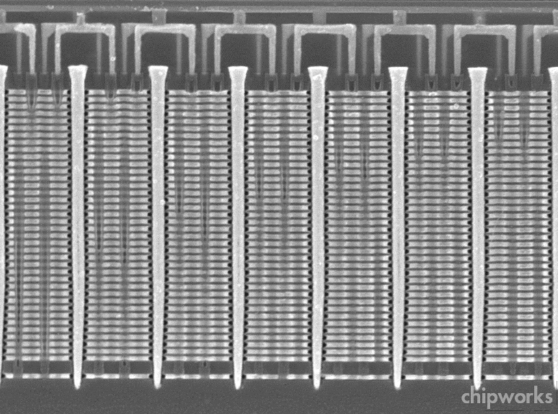
Samsung V-Nand Flash Example
Build up layers of unpatterned material
Then use lithography to slice, drill, etch, and deposit material across all layers
~30 total masking steps
Up to 48 layers of memory cells
Exploits particular structure of flash memory circuits

Slide 35
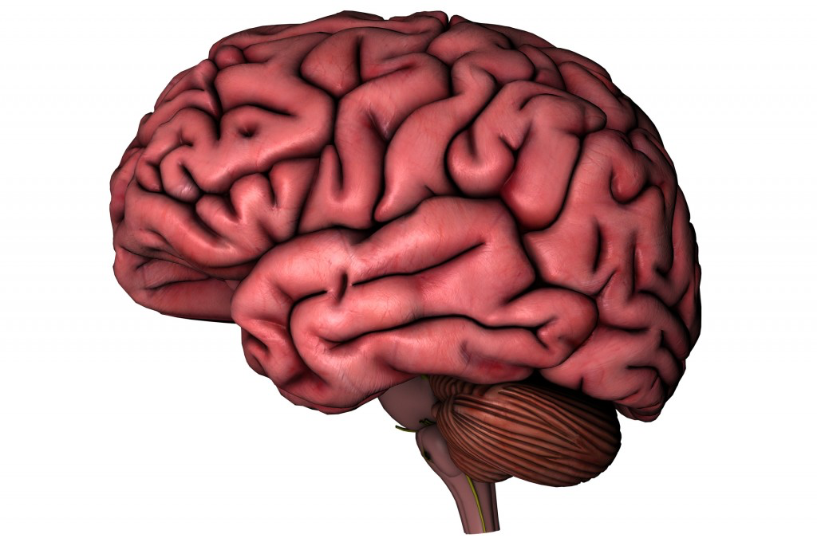
Meeting Power Constraints
2 B transistors
2 GHz operation
1—5 W
64 B neurons
100 Hz operation
15—25 W
Liquid cooling
Up to 25% body’s total energy consumption
Can we increase number of devices by 500,000x without increasing power requirement?

Slide 36
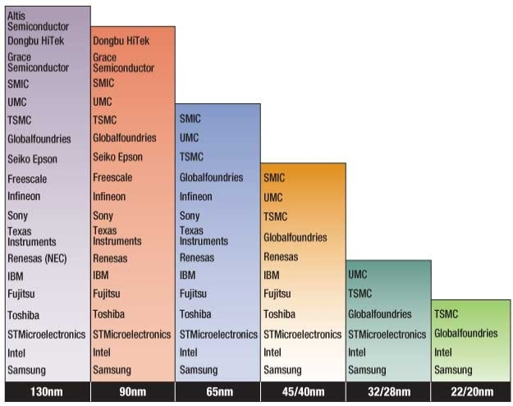
Challenges to Moore’s Law: Economic
Growing Capital Costs
State of art fab line ~$20B
Must have very high volumes to amortize investment
Has led to major consolidations

Slide 37
Dennard Scaling
Due to Robert Dennard, IBM, 1974
Quantifies benefits of Moore’s Law
How to shrink an IC Process
Reduce horizontal and vertical dimensions by k
Reduce voltage by k
Outcomes
Devices / chip increase by k²
Clock frequency increases by k
Power / chip constant
Significance
Increased capacity and performance
No increase in power

Slide 38
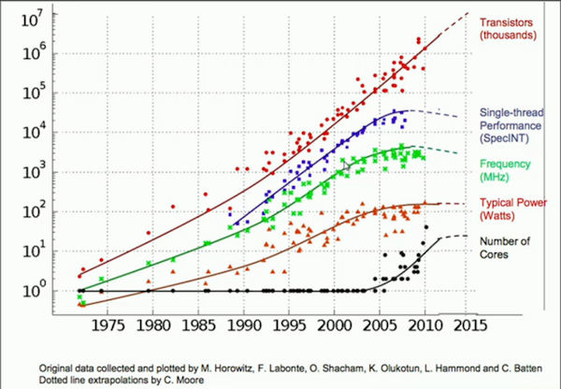
End of Dennard Scaling
What Happened?
Can’t drop voltage below ~1V
Reached limit of power / chip in 2004
More logic on chip (Moore’s Law), but can’t make them run faster
Response has been to increase cores / chip

Slide 39
Final Thoughts
Compared to future, past 50 years will seem fairly straightforward
50 years of using photolithography to pattern transistors on two-dimensional surface
Questions about future integrated systems
Can we build them?
What will be the technology?
Are they commercially viable?
Can we keep power consumption low?
What will we do with them?
How will we program / customize them?

